Slide 1

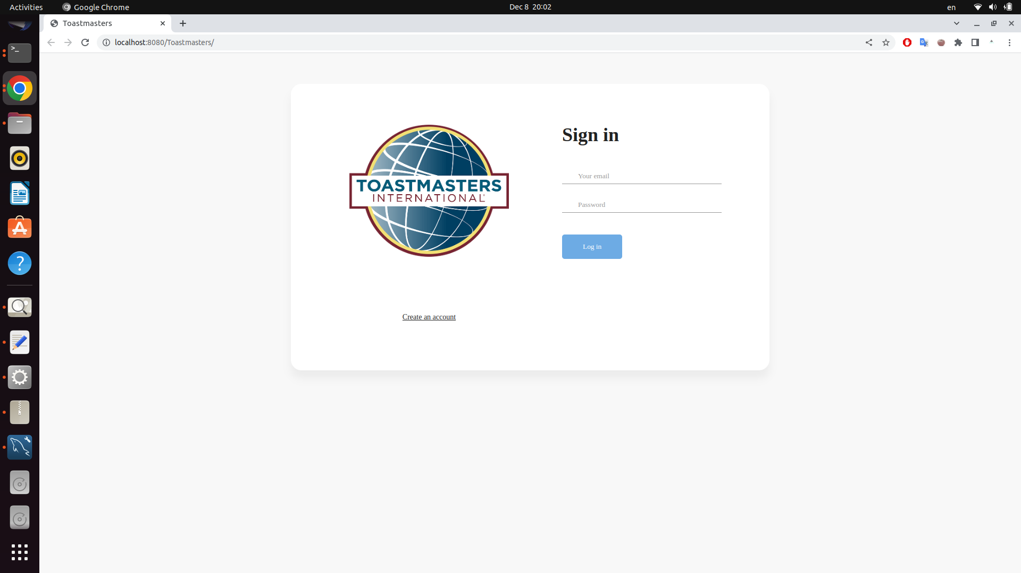
Toastmasters
Web application
Kirolos Sawiris

Slide 2
What is Toastmasters?
What for?
How to start using it?
What technologies did I use?

Slide 3
Toastmasters is a web application that aims to help you improve your public speaking by organizing meetings in which you can take a role, interact with other participants, give, and receive feedback from each other.

Slide 4
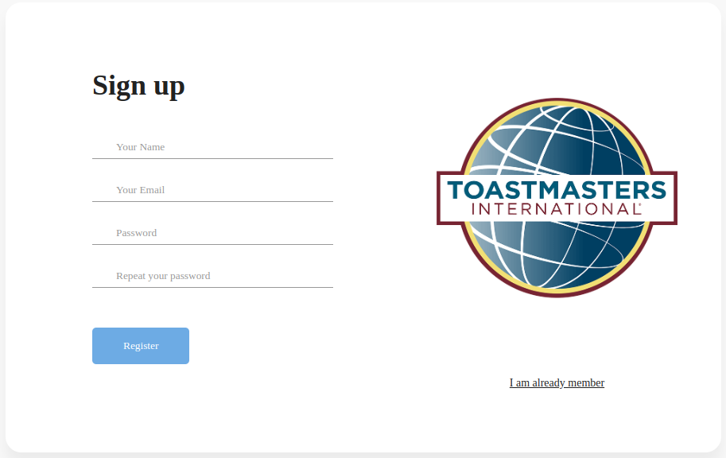
Sign up
Name
Email
Password

Slide 5
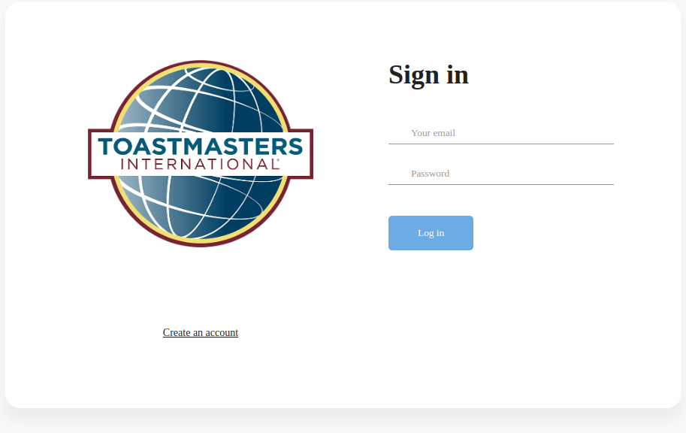
Sign in
With your Email and Password

Slide 6
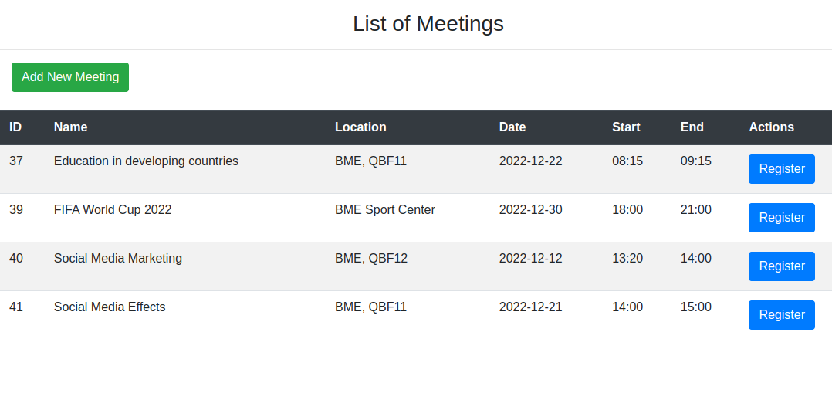
List of Meetings
1
You will see all the meetings' names, locations, dates, starts, and ends.
After choosing a suitable meeting for you. you can register for it.
If none of them suits you, you can create your own meetings by clicking on Add New Meeting with your suitable date and topic

Slide 7
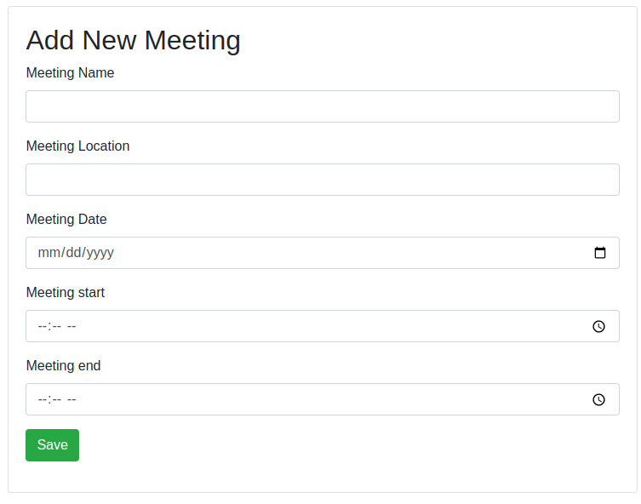
Create Meeting
1
You can create your own meeting by providing all the information that suits you like the name or the topic, location, date, start, and end.

Slide 8
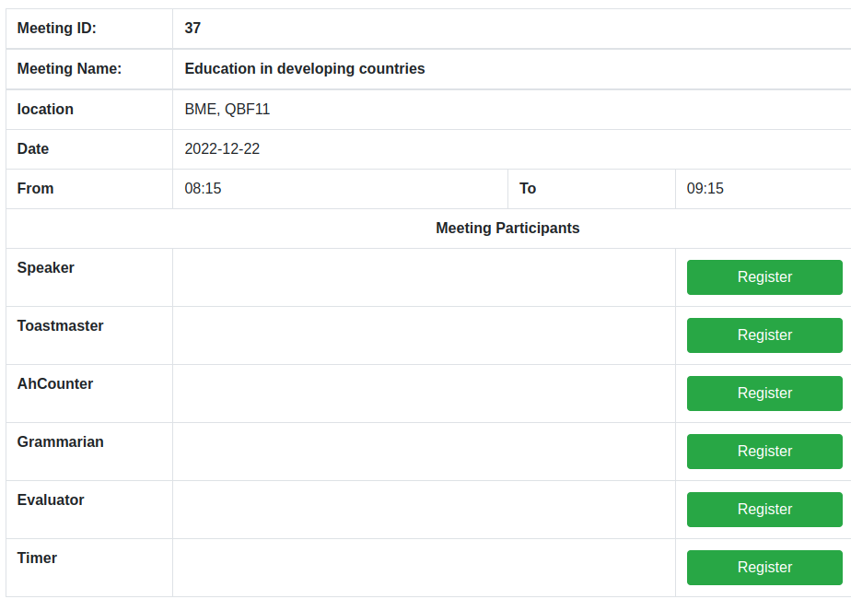
Meeting Registration
After choosing a suitable meeting for you to attend , you need to choose a role from:
Speaker
Toastmaster
Ah-Counter
Grammarian
Evaluator
Timer

Slide 9
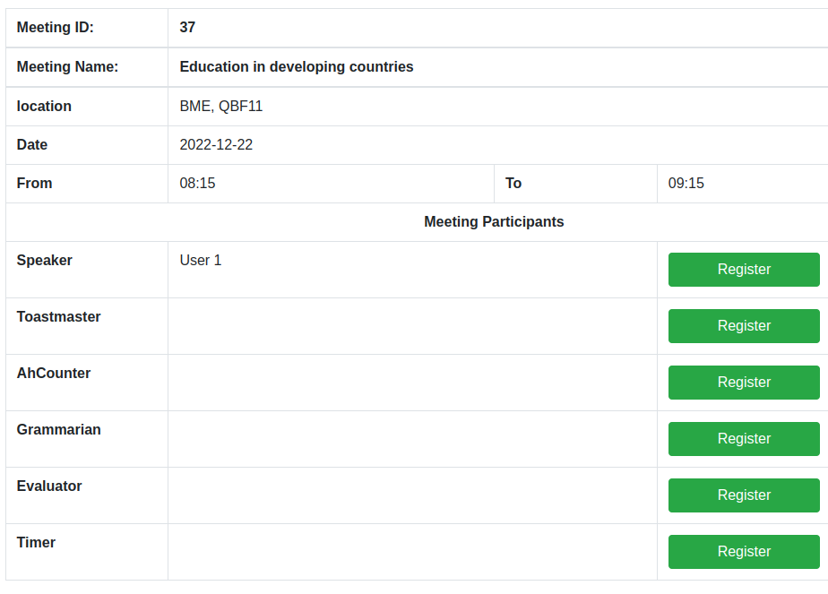
Meeting Registration
1
After choosing your role and clicking register you can find your name next to the role which means this role is reserved for you and nobody can register for this role in this specific meeting unless you dropped it.

Slide 10

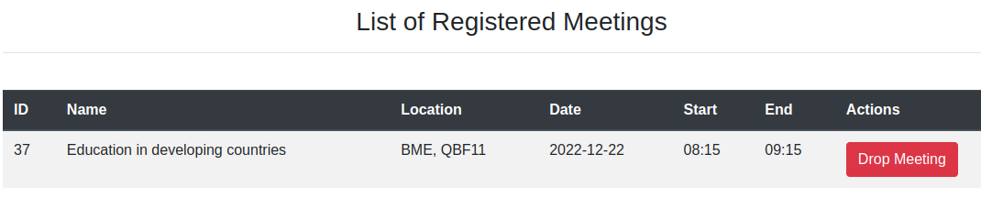
Drop Meeting
1
After clicking on Registered Meetings you can find all of your registered meetings.
Next to each meeting you can find the drop button which will drop you from this meeting.

Slide 11
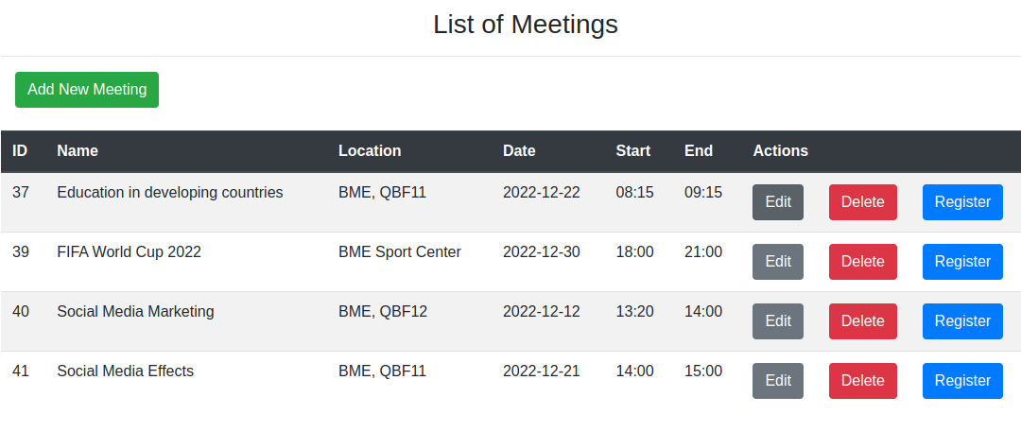
Clubmaster
1
The clubmaster is the person who created and owns the club.
The clubmaster can edit or delete a meeting, so in case of any problem, you need to contact your clubmaster.

Slide 12

Next step
Don’t forget to arrive on time at the meeting location. Have fun performing your role and improving the way you speak in front of people!

Slide 13
Technologies used
Eclipse IDE
Java EE
Jakarta Server Pages
Jakarta Servlet
Apache Tomcat
MySQL

Slide 14
Thank you

